Slide 1


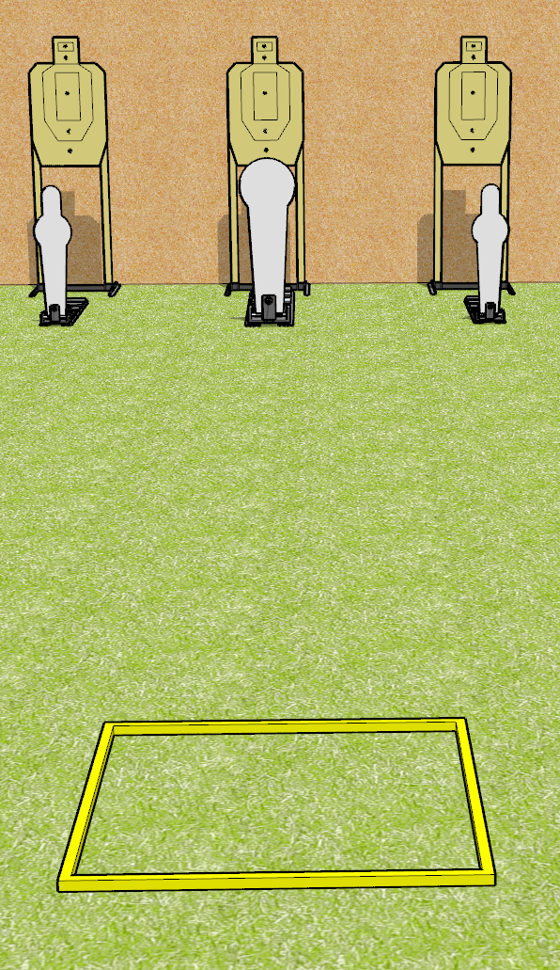
 | Dothan Gun Club – USPSA Match A Simple Speed Shoot Course Designer : Drew Coleman
Round Count 9 rounds 3 USPSA targets 2 mini poppers, 1 colt popper
Equipment List Shooting box

Slide 2
A Simple Speed Shoot
Written Stage Briefing
A Simple Speed Shoot is a 9 round, 45 point, Comstock speed shoot. There are 3 USPSA targets, 2 mini poppers, and 1 colt poppers. The best 2 hits on paper will score, and steel must fall to score. The start signal is audible.
Handgun start position is facing uprange, toes touching rear of box, wrists above shoulders. Handgun is loaded and holstered.
PCC start position is in shooting box, stock on belt. Carbine is loaded with safety on.
On start signal, engage EITHER the mini poppers, OR the Colt popper, perform a mandatory reload, and engage the remaining array. The paper targets may be engaged at any time.

Slide 3
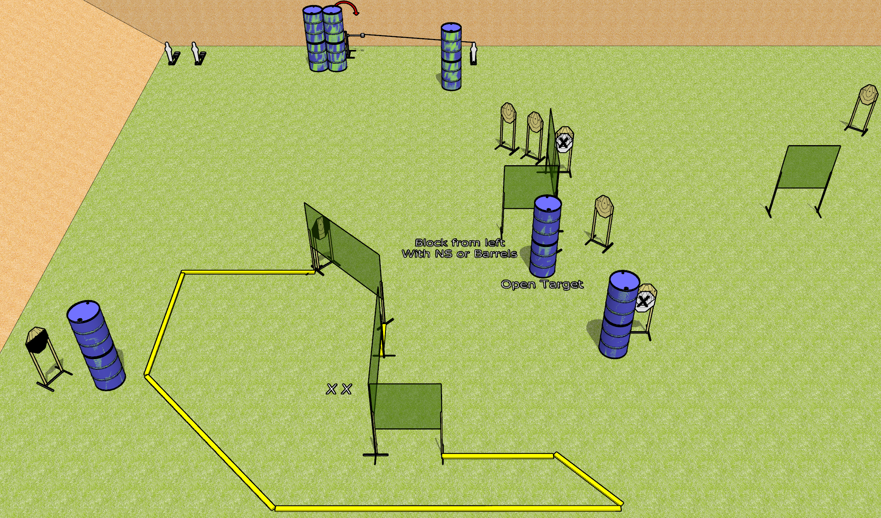
 | Dothan Gun Club – USPSA Match To the Extreme Course Designer : Drew Coleman
Round Count 23 rounds 10 IPSC 3 mini poppers
Equipment List 12 wall feet 1 medium fault line, 2 3’ fault lines 1 swinger + activator 1 tuxedo, 1 50% Aligning the activator steel: line it up with the middle of the fault line to the right of the narrow wall at the bottom of the shooting area, at 50 feet

Slide 4
To the Extreme
Written Stage Briefing
To the Extreme is a 23 round, 115 point, Comstock course of fire. There are 10 IPSC targets and 3 mini poppers. The best 2 hits on paper will score, and steel must fall to score. The start signal is audible.
The swinger is activated by the rightmost mini popper. Please check the activator prior to walkthrough and set it the same way every time.
Handgun start position is both feet on X’s, wrists below belt. Handgun is loaded and holstered.
PCC start position is both feet on X’s, stock on belt. Loaded carbine is loaded with safety on.
On start signal, engage targets as they become available from within the shooting area.

Slide 5
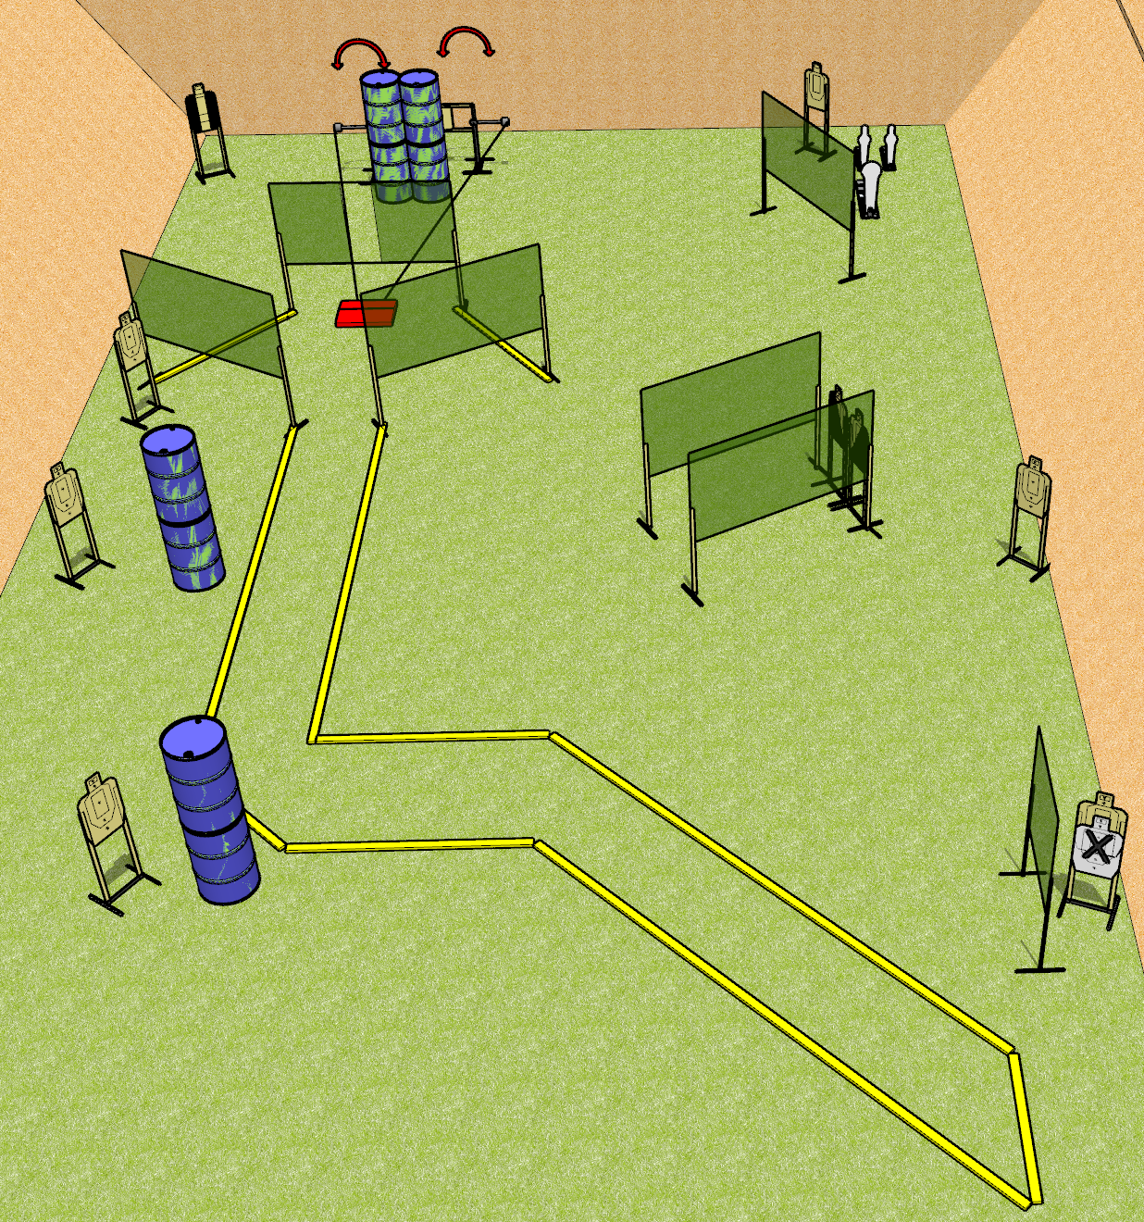
 | Dothan Gun Club – USPSA Match Not so Straight and Narrow Course Designer : Drew Coleman
Round Count 25 rounds 12 USPSA 2 mini poppers, 1 colt popper
Equipment List 2 medium fault lines 12 wall feet 2 swingers + stomp box

Slide 6
Not so Straight and Narrow
Written Stage Briefing
Not so Straight and Narrow is a 25 round, 125 point, Comstock course of fire. There are 12 USPSA targets, 2 mini poppers, and 1 colt popper. The best 2 hits on paper will score, and steel must fall to score. The start signal is audible.
The stomp box activates both swingers which remain visible at rest.
Handgun start position is inside shooting area, wrists below belt. Handgun is loaded and holstered.
PCC start position is inside shooting area, stock on belt. Carbine is loaded with safety on.
On start signal, engage targets as they become available from within the shooting area.

Slide 7
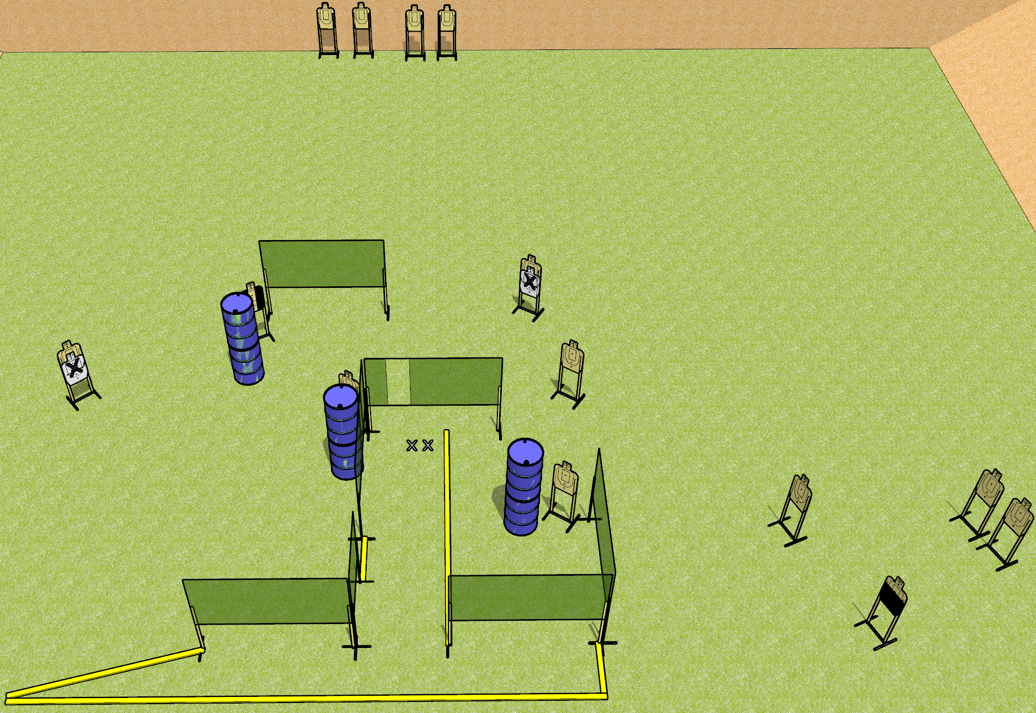
 | Dothan Gun Club – USPSA Match Use the Big Bay Course Designer : Drew Coleman
Round Count 28 rounds 14 USPSA targets
Equipment List 11 wall feet 2 3’ fault lines Use 10 foot for the far left angled part.

Slide 8
Use the Big Bay
Written Stage Briefing
Use the Big Bay is a 28 round, 140 point, Comstock course of fire. There are 14 USPSA targets. The best 2 hits on paper will score, and steel must fall to score. The start signal is audible.
Handgun start position is both feet on X’s, wrists below belt. Handgun is loaded and holstered.
PCC start position is both feet on X’s, stock on belt. Loaded carbine is held with both hands, safety on.
On start signal, engage targets as they become available from within the shooting area.

Slide 9
 | Dothan Gun Club – USPSA Match Shoot House Course Designer : Does anyone read these things?
Round Count
Equipment List

Slide 10
Shoot House
Written Stage Briefing

